Slide 1
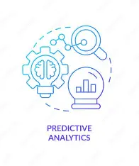
Infosys Virtual Internship PrognosAI: AI-Driven Predictive Maintenance System
Presented by-
Darshna Ujwal

Slide 2
Project Objective
To develop a reliable AI-based system that estimates the Remaining Useful Life (RUL) of turbofan engines. This prediction is based on analyzing multivariate time-series sensor data from the NASA CMAPSS dataset.
We apply Deep Learning (GRU Networks) to recognize the subtle, sequential degradation patterns in the sensor data to accurately forecast the time until failure.
The system enables proactive maintenance scheduling, directly minimizing costly unplanned downtime and maximizing the operational life and efficiency of critical assets.

Slide 3
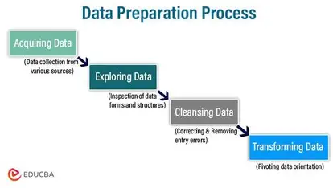
Milestone 1: Data Preparation & Feature Engineering
Data originated from the NASA CMAPSS FD001 dataset. We performed necessary cleaning steps, including removing static and irrelevant sensor columns (which have zero variance) and applying Min-Max Scaling (0 to 1) to all dynamic features for GRU stability.
The RUL target variable was calculated for every engine cycle as: RUL = Total\ Cycles - Current\ Cycle. We applied Min-Max Scaling to all dynamic features, normalizing values between 0 and 1 to ensure neural network stability.
We converted the flat data into a 3D format using a 50-cycle rolling window (Sequences). This structure is essential for training Recurrent Neural Networks (RNNs) to analyze history.

Slide 4
Milestone 2: Model Architecture and Optimization
Gated Recurrent Unit (GRU) Network. Selected over LSTM for its combination of efficiency and strong performance in time-series prediction.
A robust stacked design (128 -> 64 units) to effectively capture long-term memory in the 50-cycle sequences.
RUL Clipping (100 Cycles): We capped the target RUL at 100. This forces the model's predictive power onto the critical 100 cycles before failure, which is the key to achieving high R².
Unit-Based Splitting: We used “GroupShuffleSplit” to ensure the test data only contains entirely unseen engine IDs. This guarantees the model's high R² genuinely proves its ability to generalize to new machines.

Slide 5
Milestone 3: Performance and Predictive Reliability
Final R-squared (R²): >0.95. (Explains over 95\% of the degradation variance.)
Root Mean Squared Error (RMSE): <7.3 cycles. This means the average prediction error is extremely low.
Charts comparing Predicted RUL vs. Actual RUL confirm strong visual consistency.
Error Histogram shows errors are tightly centered at zero, proving the model has no significant systemic bias to predict RUL too early or too late.

Slide 6
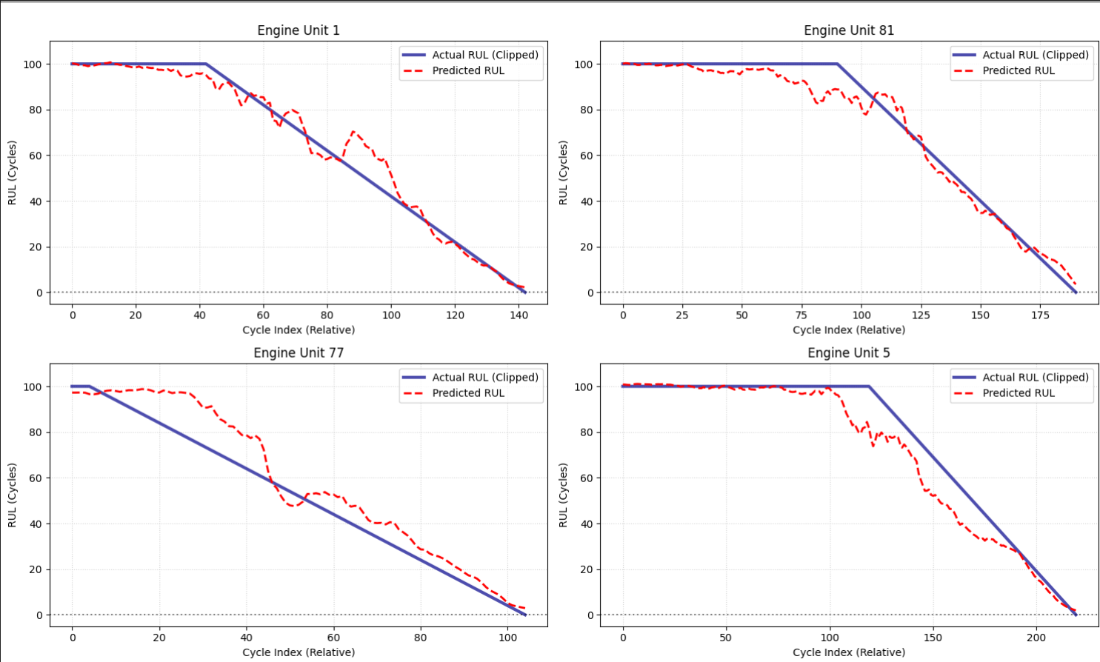
Milestone 3 visualization

Slide 7
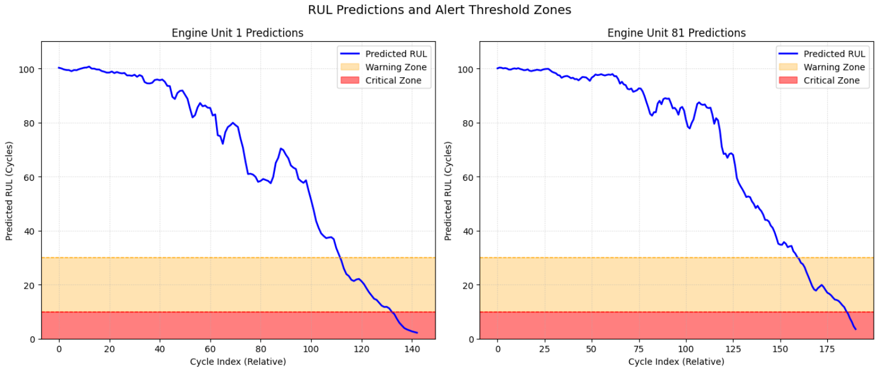
M4: Risk Thresholding and Alert System
Translate numerical RUL predictions into clear, actionable commands for maintenance staff.
Warning Zone: RUL: 30 cycles. (High-priority planning required). Critical Zone: RUL 10 cycles. (Immediate action/Asset must be grounded).
Custom Python logic automatically classifies every new prediction into HEALTHY, WARNING, or CRITICAL status.
This layer transforms a mathematical result into a crucial business signal, allowing for timely intervention based on defined risk levels.

Slide 8
M5: Visualization and Dashboard Development
Platform- Streamlit (Python Application) and Plotly (Interactive Charts).
A user-friendly, responsive dashboard that allows users to select individual Engine Units for analysis via a sidebar.
Interactive RUL Trend Chart: Plots the degradation trend against the maintenance alert zones, providing zoom and hover functionality for precise data inspection.
The dashboard is clear, responsive, and meets all requirements for conveying asset health and potential risks to the user.

Slide 9
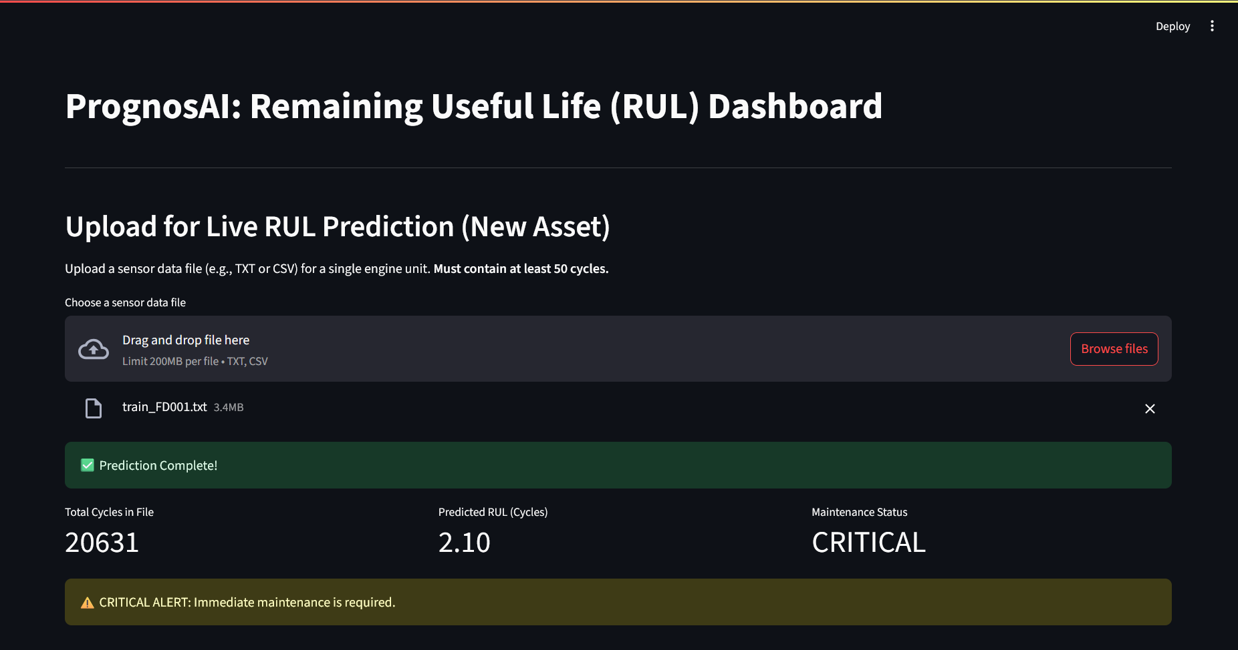
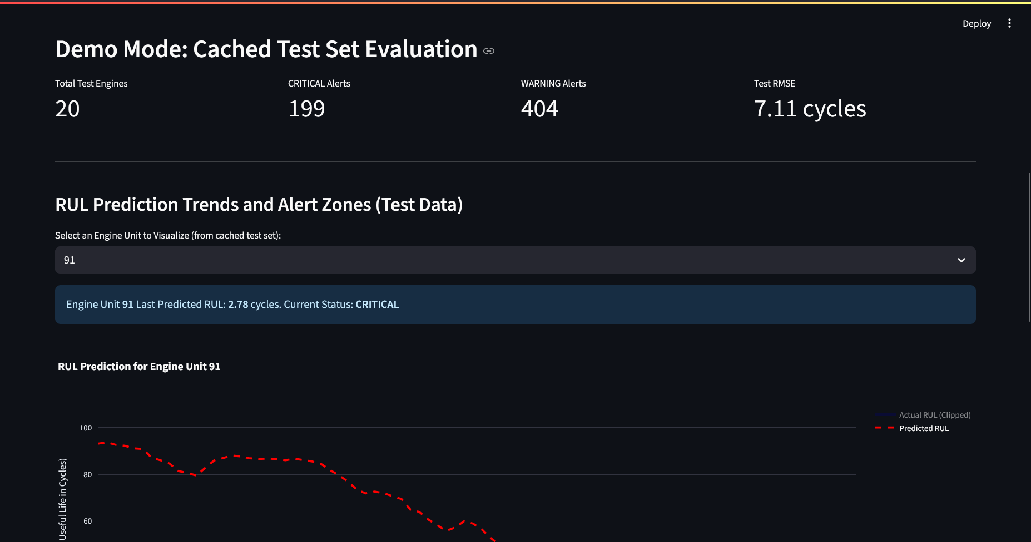
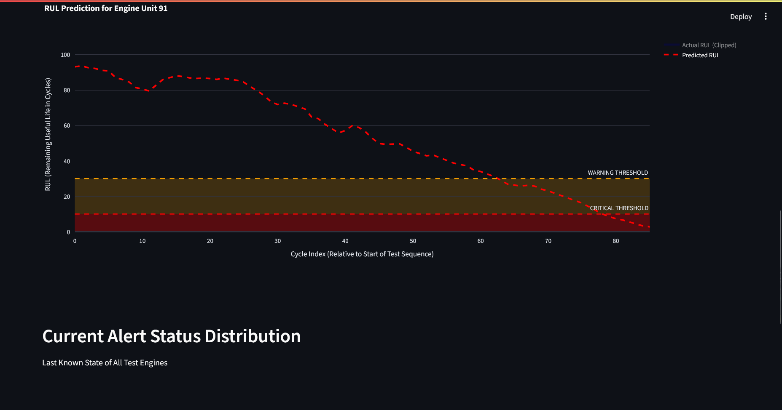
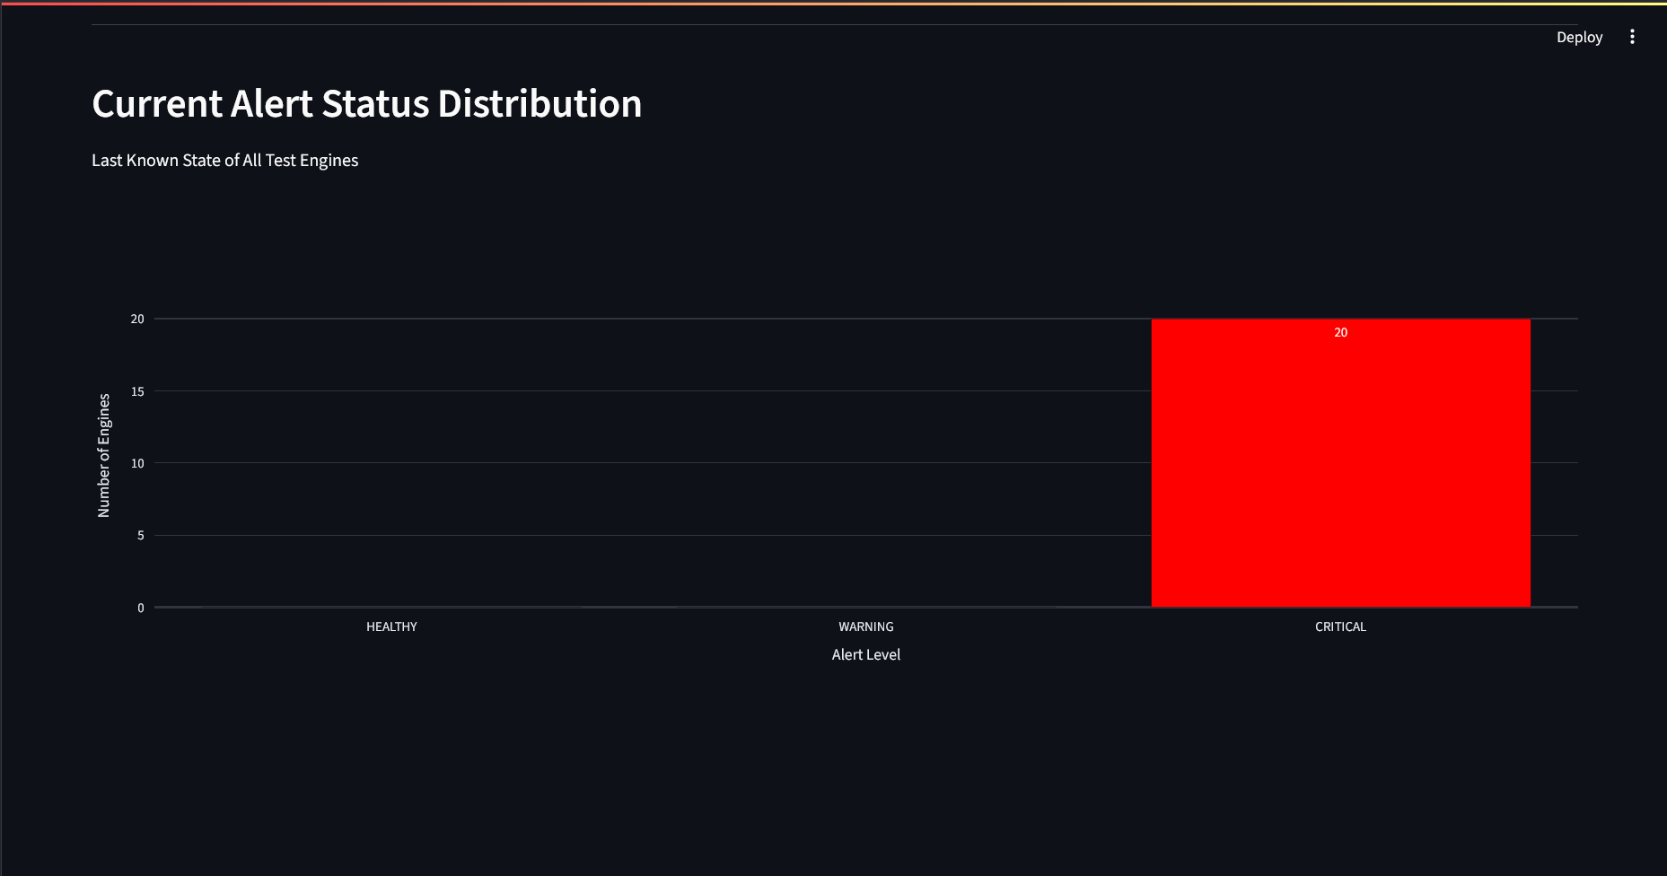
Output Screens

Slide 10
Project Summary: From Data to Decision
M1 & M2 - Data Foundation & Training: Successfully preprocessed data, applied RUL Clipping, and trained a GRU network to achieve R² > 0.95 precision.
M3 & M4 - Validation & Action: Proved model reliability (zero bias) and implemented the Warning/Critical alert system logic.
M5 - Deployment: Delivered a functional, integrated Streamlit Dashboard for user interaction and real-time visualization of predictions and alerts.

Slide 11


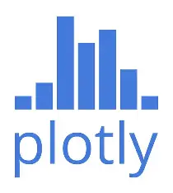
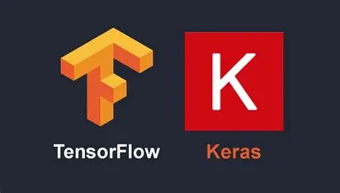
Technical Stack and Deliverables
Tech Stack - Python, Pandas, NumPy (Data), TensorFlow/Keras (GRU Model), Streamlit (Dashboard), Plotly (Interactive Charts).Final
Deliverables - best\_rul\_gru\_model.h5 (Trained Model), 3\_evaluation\_and\_alerting.ipynb (Analysis), prognosai\_dashboard.py (Final Application).

Slide 12
Conclusion: PrognosAI is Production-Ready
Final Impact - The system provides a highly accurate, reliable, and actionable solution to a critical industry problem: minimizing unplanned downtime.
Achieved R² > 0.95 Precision using a high-performance GRU Deep Learning Network
Actionable Intelligence: Successfully implemented the Warning/Critical alert system logic to translate predictions into clear maintenance actions
Future Work - Expand the model's scope to other CMAPSS datasets for multi-fleet generalization. Integrate financial modules to calculate the cost savings achieved through preventative maintenance.

Slide 13

Acknowledgement
I would like to express my deepest gratitude to my mentor, Mr. Prathap Reddy, for their unwavering support, invaluable guidance, and insightful feedback throughout this Infosys Virtual Internship and the development of the PrognosAI project.
Their expertise and consistent encouragement were instrumental in navigating the complexities of this project and achieving the project's high-precision results. This accomplishment is a direct reflection of their mentorship.
Thank you for empowering me to transform a challenging concept into a production-ready solution.

